Slide 1
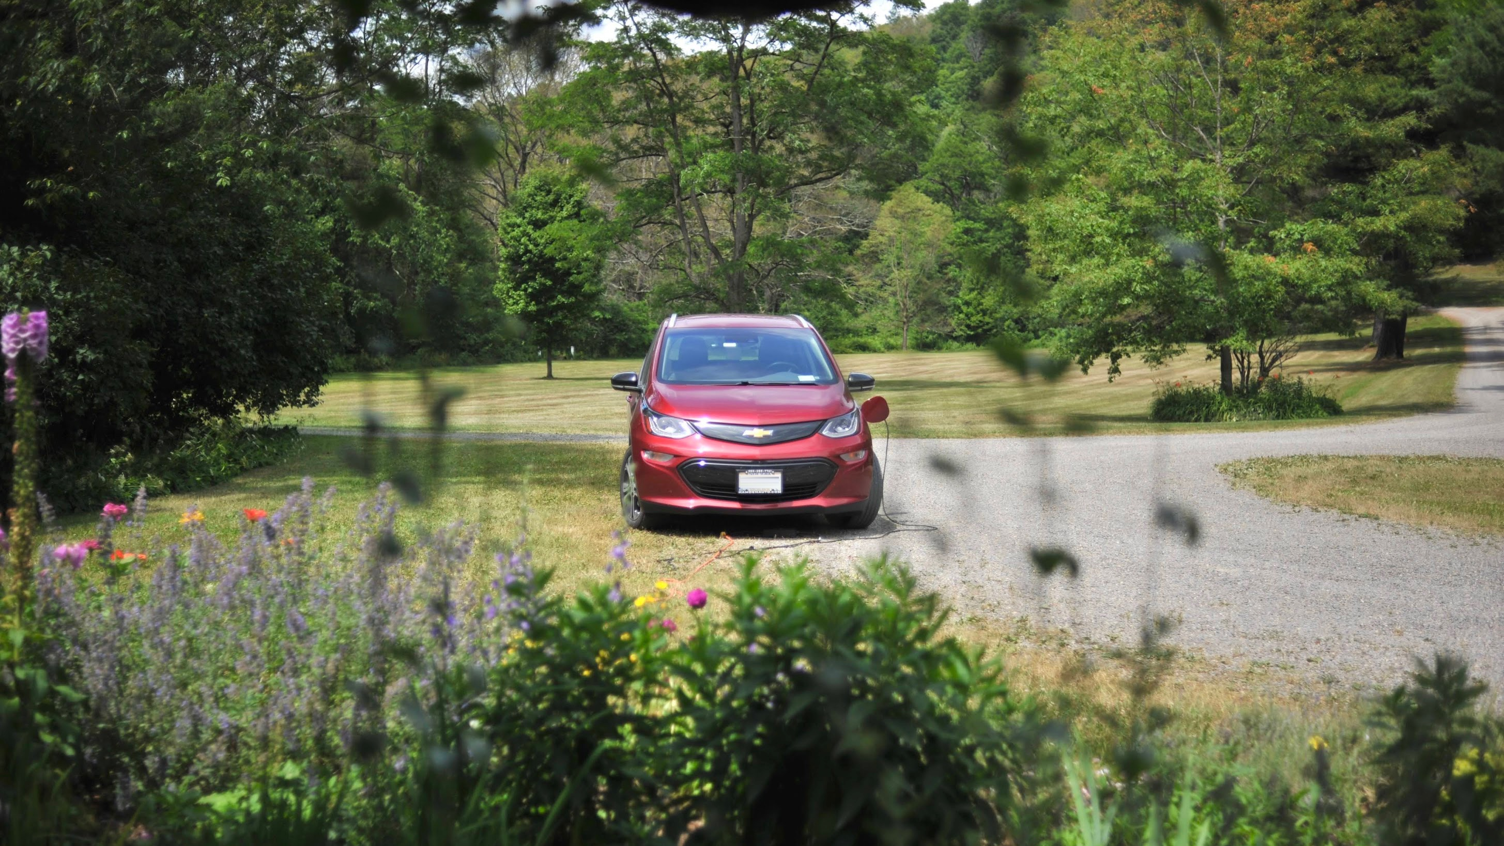
The Data Behind EV Driving
Debunking Common Electric Vehicle Myths
NYC Data Science Academy – Python Project
December 23, 2022
Brian Ralston
Notes:
Thank you all for your time, and welcome to my presentation: “The Data Behind EV Driving: debunking Common Electric Vehicle Myths”
For my presentation, I chose to explore a data set that I collected on my own.

Slide 2









Internet of Things
Notes:
Private data has exploded over the past 10 years and become more and more accessible to the everyday user.
The power to collect your own data has shifted away from government and corporate entities, and is now in the hands of the individual.
The internet of things market is estimated to be a $1/2 Trillion Dollars industry with over 11 billion connected devises in 2021
Our Lives are filled with personal data from a wearable fitness devices collecting your heart rate, to a smart plug, detecting how much electricity you are using.

Slide 3
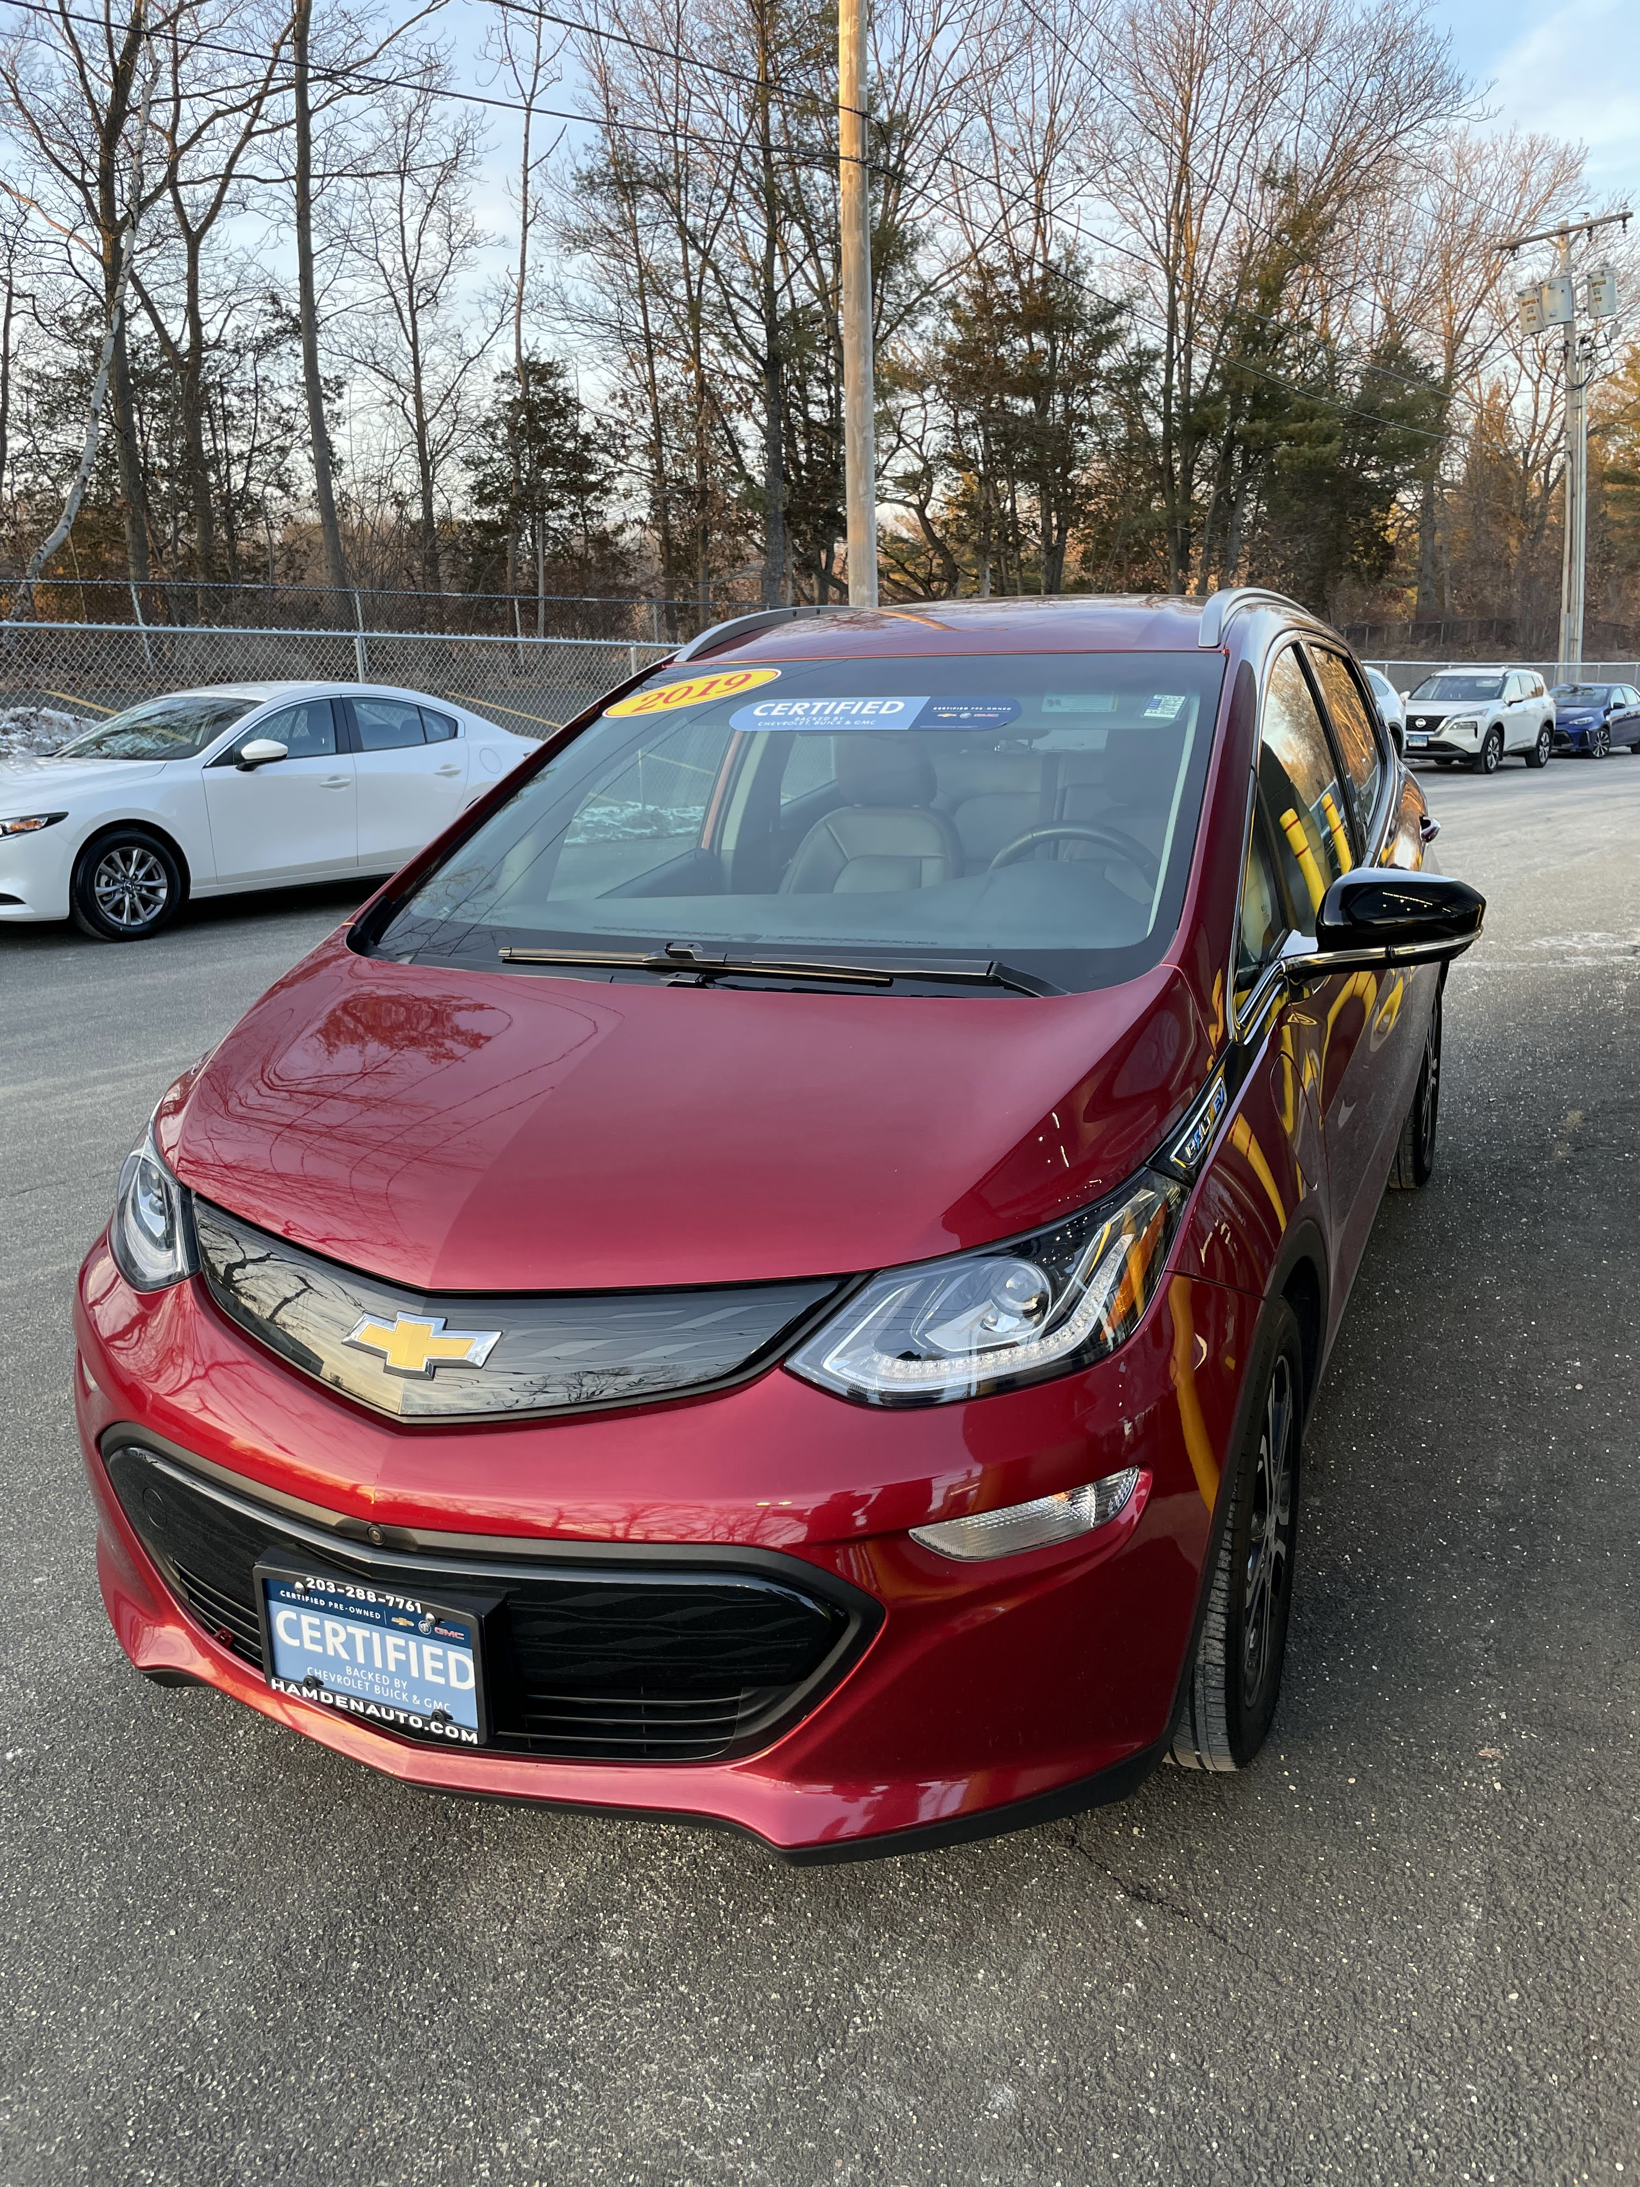
2019 Chevy Bolt
Fully Electric
238 mi range
66 kWh Battery
Subcompact car: seats 5
Charge at home, or on the go
Notes:
This past February, my wife and I took the leap, and purchased an electric vehicle. A Fully-Electric 2019 Chevy Bolt with and EPA estimated range of 238 mi.
None of our friends and family had an electric vehicle, so we were scrounging for information about EV’s and the lifestyle change.
Leading up to the purchase, we did a ton of research, but still felt stuck wrestling with competing narratives about ‘going electric’
I scoured reddit forums, Chevy forums, and electric car YouTube channels for MONTHS leading up to this, and still there wasn’t enough clear data for me to feel very confident going into the purchase.
I’m a very type A person, so actually purchasing a vehicle without 100% confidence felt like jumping into the unknown.
Just real Quick: I wan to give you a crash course in some of this terminology and relate it to a gas car so that the information can be better understood.
66 kWh battery is like your gas tank. So you could think of this as like a 13 gallon tank for example.
The batteries range is COMPLETELy dependet on a large variety of factors , which we will explore later, but just like a gas car, that number is ever changing.
The car also does not measure it self in MPG. It measures in mi/Kwh

Slide 4
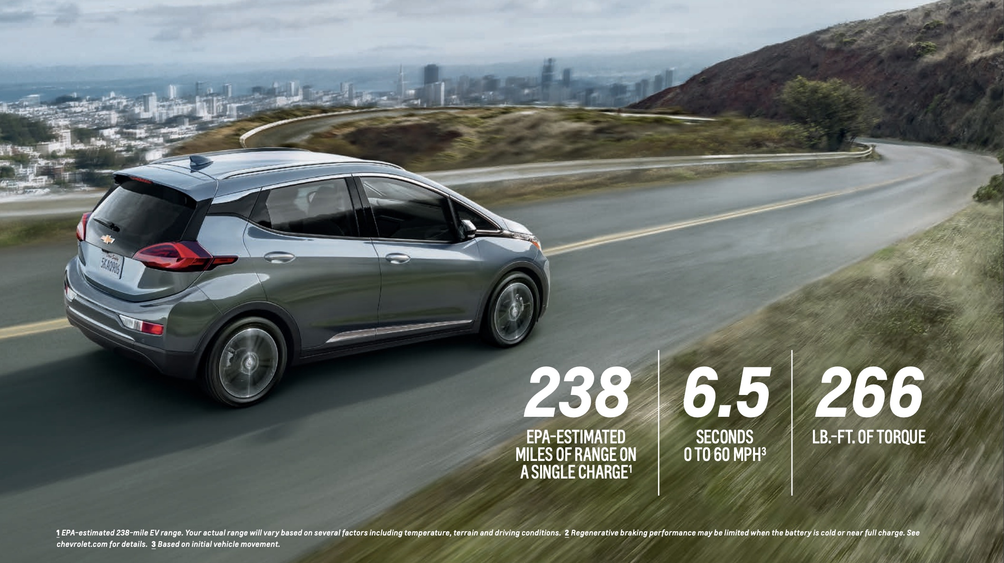
Notes:
Going into the purchase, I knew the following: That the car:
Has a range of 238 mi
It has a 200 horsepower motor with a 66kWh battery
And it can be plugged into a regular 120v wall outlet, a special 240v outlet, or I could charge on the go at one of the many charging stations.
But I still felt like there were these lingering myths I had been hearing so much about on the internet:

Slide 5


Myth #1: EV’s can’t drive very far, and I’ll get stranded on the side of the road
Myth #2: The cold weather limits the battery’s range
Myth #3: My electric bill will go through the roof charging a car at home; it’s cheaper to just fill up at a gas station.
Notes:
The three most common myths that I heard were:
Myth #1: EV’s can’t drive very far, and I’ll be stranded on the side of the road
Myth #2: The cold weather limit’s the battery range
Myth #3: My electric bill will go through the roof charging a car at home, it’s cheaper to just fill up at a gas station
Once I finally had the car in hand, I needed to know how much of this was true.
So, I went online and bought an OBDII sensor that could be plugged into my car to actually test the validity of these myths.

Slide 6
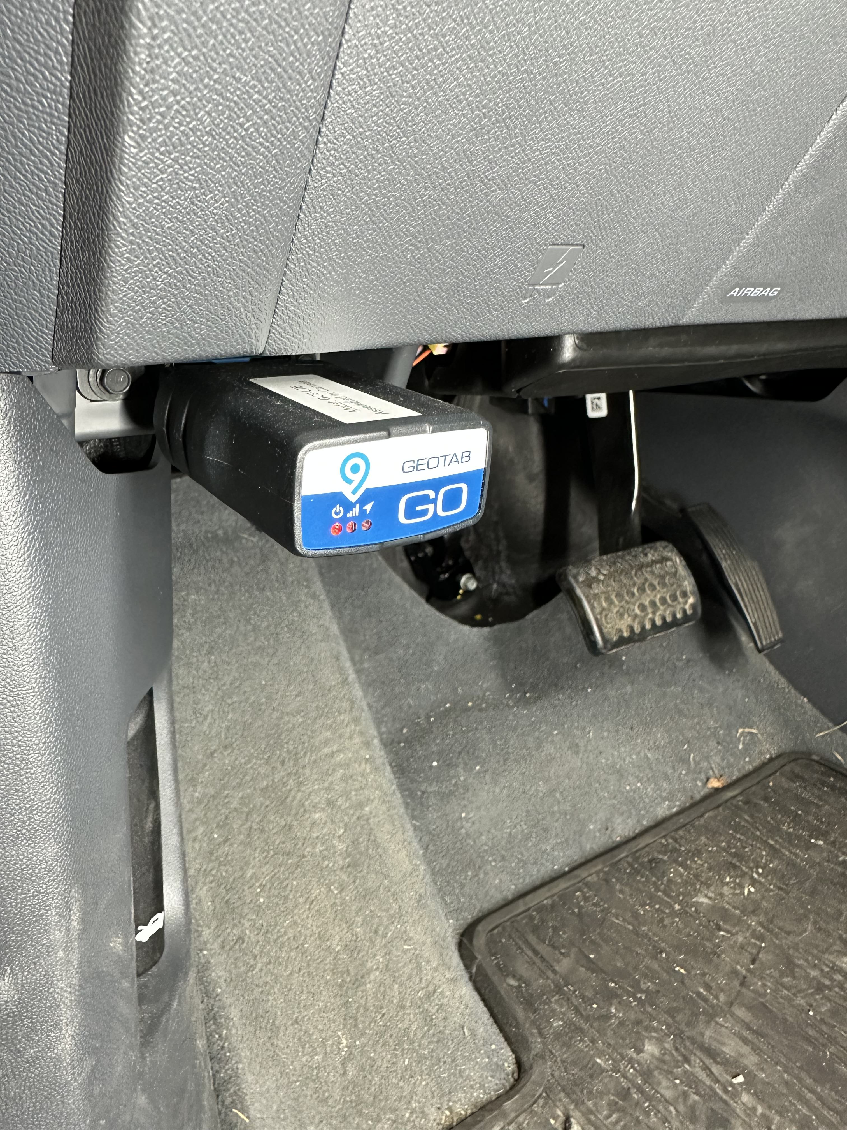
Notes:
So starting on February 24th I plugged the device into my car and was able to track data from every trip.
Every time I turn the car on, then off, it was logged as a trip and sent to an online account.
From there I was able to download my data into a .csv
I was able to collect the following data points for every trip:

Slide 7






Data Collection
Start/End Date Time
Distance Driven (mi)
Electricity Consumed (kWh)
Start/End State of Charge (%)
Outside Temperature (F)
GPS
Notes:
So starting on February 24th I plugged the device into my car and was able to track data from every trip.
Every time I turn the car on, then off, it was logged as a trip and sent to an online account.
From there I was able to download my data into a .csv
I was able to collect the following data points for every trip:
Start and End times with the data attached
Distance driven, in miles
Electricity Consumed, in kWh
What % my battery was at the beginning and end of the trip.
And the Outside Temperature.
I was unable to collect GPS data, because my device did not have this functionality.
Let’s now take a look at a quick summary of my entire trip dataset that I collected, and then we will jump straight into the mythbusting.

Slide 8


Notes:
The data set collection took place over 296 days.

Slide 9





296 Days
Notes:
Ranging from feb 24th 2022 to dec 17th 2022

Slide 10


1,092 Trips
296 Days
Notes:
1,092 Trips, mostly in the Westchester, NY area, but with road trips all over the northeast like, trips to western NY, Virginia, Penssylvania etc.

Slide 11
1,092 Trips
296 Days
23°F - 100°F
Notes:
With a range of temperatures from 23 degrees Fahrenheit to 100 degrees Fahrenheit

Slide 12
17,400 mi
1,092 Trips
296 Days
23°F - 100°F
Notes:
All trips totaling 17,400 miles

Slide 13
17,400 mi
4,251 kWh
1,092 Trips
296 Days
23°F - 100°F
Notes:
I used a total of 4,251 kWh, or the equivalent of using a household refrigerator for around 3 years
kWh is a unit of energy (not time)

Slide 14
17,400 mi
4,251 kWh
1,092 Trips
3.69 _{trips/day}
67.4 _{mi/day}
296 Days
23°F - 100°F
Notes:
I drove an average of 67 mi per day and had an average of 3.6 trips per day.
For reference the average American rives 37 mi per day
.
.
.
So now that I have an awesome dataset with over 1,000 observations, I am able to address these myths.
So let’s start with the first one, where we hone in on the distance data collected

Slide 15
Myth #1: EV’s can’t drive very far, and I’ll get stranded on the side of the road
Notes:
Myth #1: EV’s can’t drive very far, and I’ll be stranded on the side of the road

Slide 16

Myth #1: EV’s can’t drive very far, and I’ll get stranded on the side of the road
Longest Trip: 177 miles
Largest Distance in a day: 352 Miles
Avg Distance per day: 67.4 miles
Avg start of trip: 73%
Avg start of trip: 219 miles of range
Avg end of trip: 199 miles of range
Notes:
I think the summary stat’s I provided did a great job of busting this myth, but let’s add some additional context here.
On Avg, I started every trip with a battery charge of 73%, that means that on Average I would start a trip with 216 miles of range and that also means that I would on average and a trip with 199 miles of range
AS far as getting stuck on the side of the road, there were only TWO instances where I was pushing the limits of the range of the car. I ended 2 two trips with less than 5% battery, but never did end of stuck on the side of the road.
The longest length of a single trip was 177 miles, and the most miles I drove in 1 day was 351.69 miles.
So with this data, I can confidently say that this myth is incorrect.
The Chevy Bolt has enough range for my frequent driver lifestyle and there was a very low chance I would end up stuck on the side of the road. At least the same change as a gas car in that It was my own choice to push the limits of the car.

Slide 17

How efficient is my car?
4.5 mi/kWh
Notes:
So what Else did I find when looking into distance and efficiency?
On all 1092 trips, I averaged 4.5 kWh. To make this number easier to understand, there is a conversation available from mi/kWh to MPG, called MPGeq. If this car was a gas vehicle it would be getting 152 MPG.
This got me thinking about if there is anything that affects efficiency on my car?
-->Maybe distance has an effect? Maybe the farther I drive the more “Fuel efficient”
-->Maybe Time of day has an effect on efficiency?
-->Maybe how cold or hot it is has an effect on efficiency?
Let’s explore the data set a bit deeper to address each of those ideas.
Let’s First Look at Distance.

Slide 18
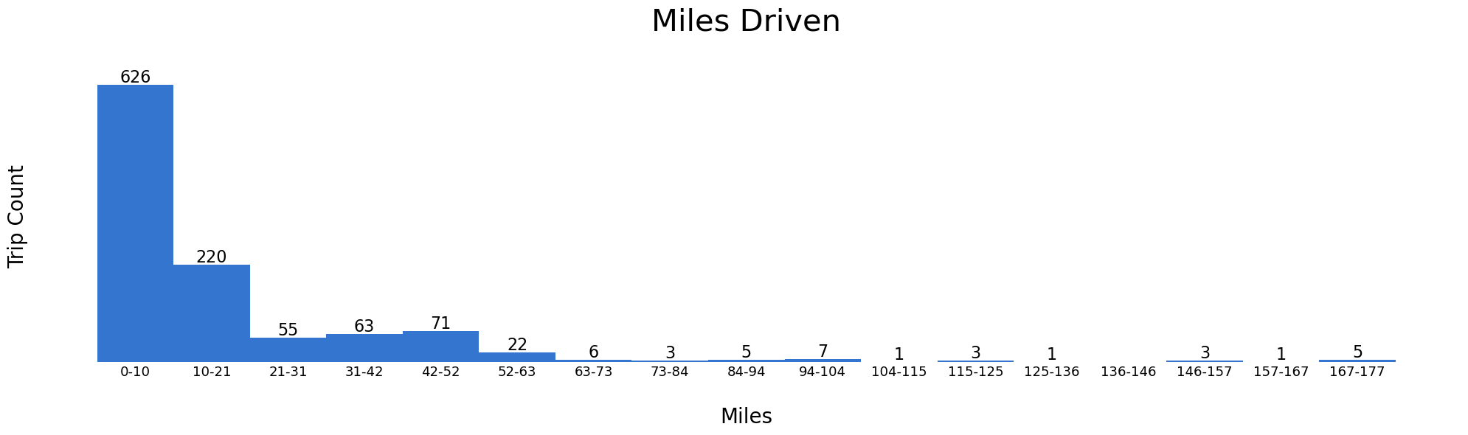
Notes:
You can see here the different groupings of distances that I drove over the past year.
They are grouped into a bin range of around 10 mi.
On the left side of the graph, you can see that a 626 trips, a vast majority of trips, took place in the 0-10 mile trip range.
Let's break this data up into three areas: Short, medium and long trips. That way we can get a better sense to see if there is any correlation between distance driven, and how efficient the car is.
Let's start with Short Trips:

Slide 19
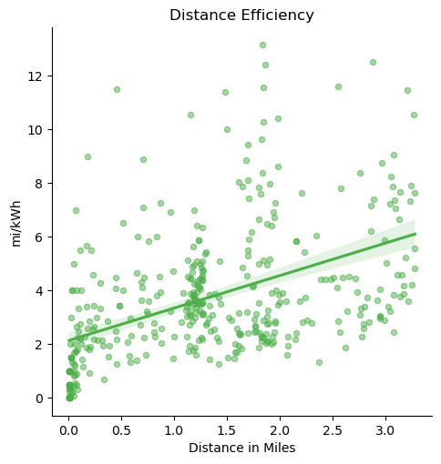


Notes:
I've defined Short trips as less than 3.3 miles.
So you can see here that visually, there seems to be a positive trending correlation between the two variables. Without running any numbers, it looks like the farther you drive, the more efficient your car is.
Although the data is VERY widespread on the Y axis: mi/kWh.
Anecdotally, When I am driving, I never see avg’s above 5 or 6, and definitely not below 2 in the car’s dashboard avg.
So this data may be too isolated.
I also notice a strong grouping around 0 miles, and 1.2 miles. There are a lot of times that I turn on the car to move it down the driveway, or move it quickly and then turn it off.
There is also a clump around 1.2, which happens to be the exact distance to our downtown, with our favorite coffee shop. It’s pretty cool to see that represented.
So, let’s expand the data set to include medium distance and see if that can give us a better picture.

Slide 20
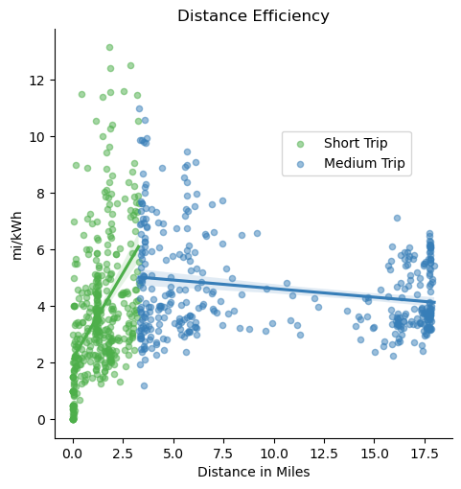

Notes:
I have defined medium trips from as a range from 3.3 to 18 miles.
This data provides us with Much more context.
Although it seems to have a VERY different result compared to the short trips.
In the medium trips, the farther you drive, it looks like the less efficient your car is.
The efficiency range looks to be a little less too. They are not as widespread as the short trips.
Another fun side note, see that chunk around 18 miles that’s My wife’s commute to her teaching job. It is exactly 17.9 miles long one way.
Any way, let’s include the long trips to get the overall picture.

Slide 21
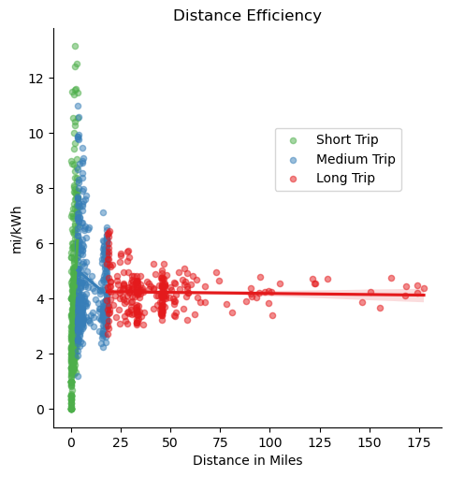

Notes:
Ah, here we can see the wide range of data.
It seems that with the long trips, there isn’t really a correlation, it just stays pretty consistant.
So maybe that’s not the right conclusion. However I think the right conclusion from this data is that the farther you drive, the more CONSISTANT the effeeciency it.
The conclusion can’t be made with these visuals to show that there is an improvement to efficiency the farther you drive.
And the last fun side note of this section: that concentration around 48 miles is where I work. I think it’s reall cool to see that reflected in the data.
Let’s do one last thing to this visual so that we can see the short trips with all groupsings together.
Let’s look at this data with the x axis in Log Scale:

Slide 22
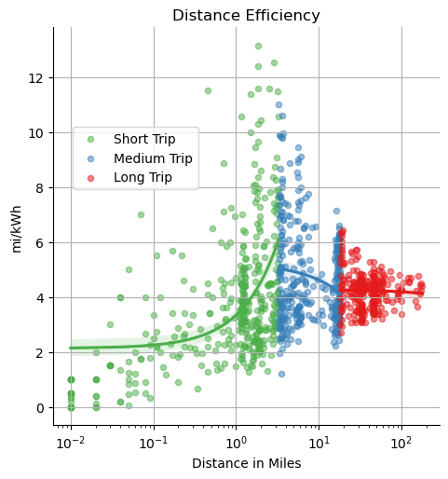
Notes:
That looks a lot clearer and I think shows everything we talked about with distance very nicely.
Okay, let’s move onto to see if Time of day has any effect on efficiency.

Slide 23
Time of Day

Slide 24
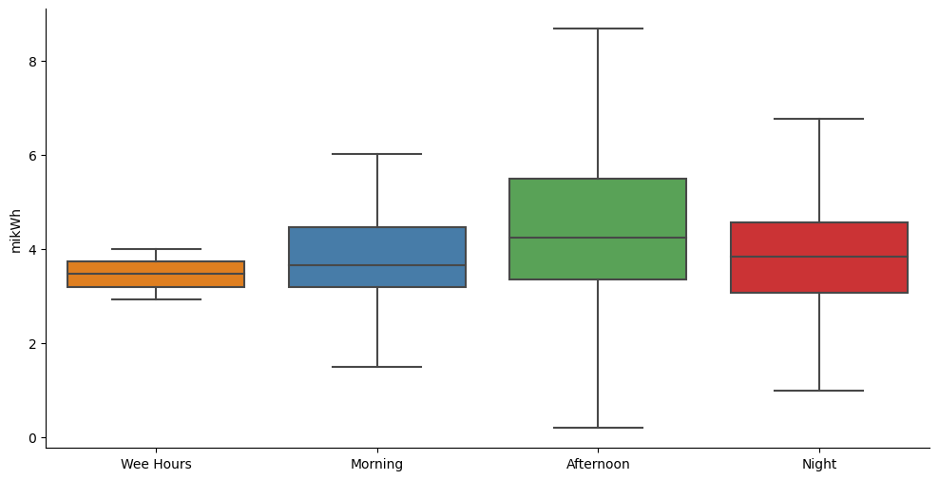
Notes:
This time I have decided show the data in a box plot and to group the data into 4 separate categories.
Trips that started before 6am were the “wee hours”
Trips that started in between 6-12 were the morning
Trips that started in between 12-6 were the afternoon
And lastly night trips were in between 6pm and midnight
With boxplots, the middle line represents the median of the data, so looking at that it doesn’t seem t ohave a great variance in terms of efficiency.
It seems to hover around the 3.8 to 4.1 mark.
It’s tough to say what is going on here, but I don’t think time of day has a great effect on efficiency..
But again, there is a story around the RANGE of efficiency.
It seems as though the afternoons have the greatest range.
Again, it’s tough to say by just looking at visuals, but this might be a story of traffic and how sitting in traffic has a big affect on efficiency?
Either that, or maybe the greatest amount of the trip data sits in the afternoon and that’s why the range is so big. Any way I don’t want to get hung up on this, but thought it was an interesting data point non the less.
Let’s move onto one of my favorite parts of the dataset, and the next MYTH.

Slide 25
Myth #2: The cold weather limits the battery’s range
Notes:
Myth #2: The cold weather limits the battery’s range
I had heard a lot about this before purchasing the car, but numbers were really hard to come by, especially for the chevy bolt for some reason. The tesla had a lot of crowd sourced data, but not the BOLT.
Ichevy definetly doesn’t advertise this type of stuff. t’s almost like Chevy DOESN’t want you to know this data?!
Any way, let’s first jump into it by creating a scatter plot of the outside temperature against the mi/kWh

Slide 26
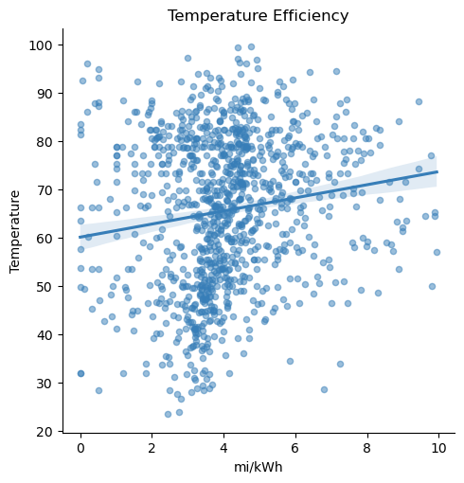
Notes:
Looking at this scatter plot it looks like SOME visual relationship between higher temperature, and higher efficiency. It’s hard to see in the way it’s shown right now, but it almost looks like as you follow the grouping from top to bottom, that it leans right, potentially meaning, that in the warmer weather it does better, and in the cold weather it does worse.
so let’s go one step further and break this dataset into 3 groups: Cold, Regular, and hot, and we will compare them each to mi/kWh
Let’s Start with cold temperatures, which I have defined as below 40 degrees F

Slide 27
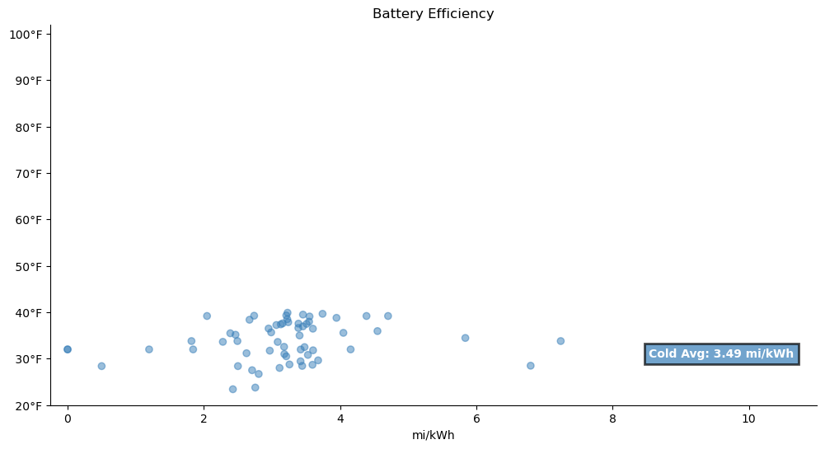
Notes:
Okay great, so we have some data points, and when we take the efficiency averages of that data set, it looks like we come to an average of 3.49 mi/kWh.
Okay great, is that good? Not sure yet… so let’s add in the normal temperatures which I have defined as between 40-70 degrees F

Slide 28
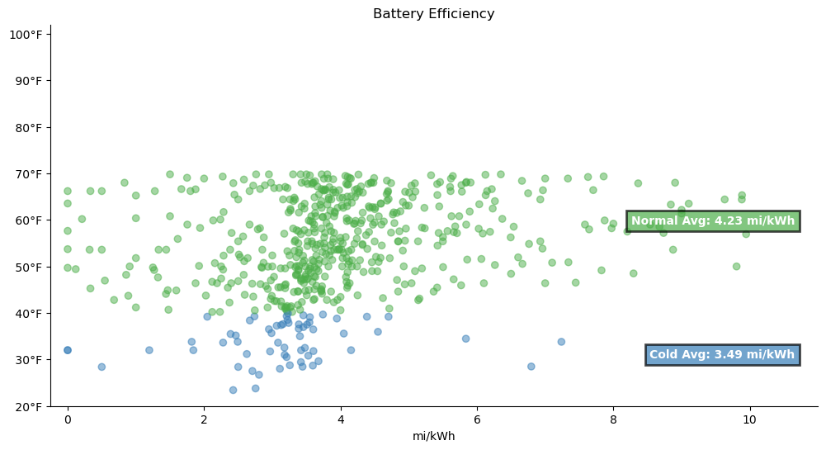
Notes:
Okay, the newly added green scatter plot points are displayed, and after doing a calculation of this isolated data grouping, it looks like it has an avg of 4.23 mikWh
This looks like a step in the direction of confirming the myth. It seems as though the warmer it gets, the better, the colder, the worse.
Lets add in the final grouping and see if our theory stays true.

Slide 29
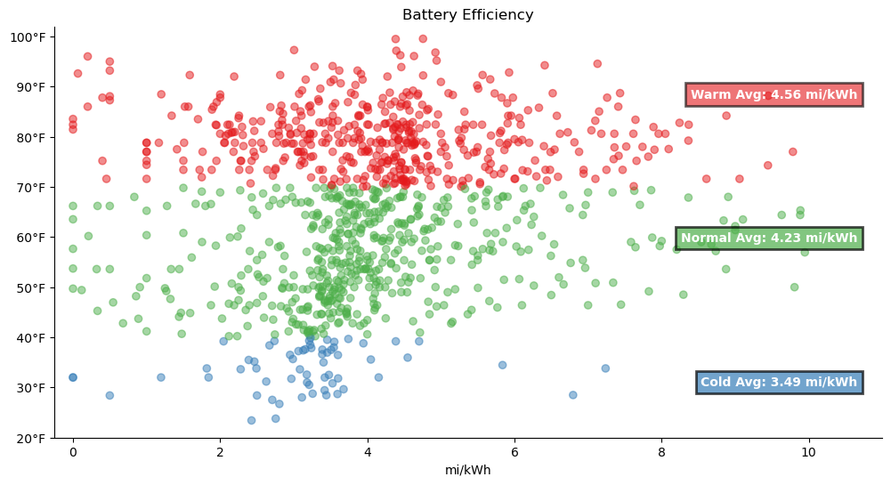
Notes:
Okay definitely.
Taking the average of the grouping of hot temperatures, which I have defined as 70 and above, the average is 4.56 mi/kWh
There is a definite trend. When its hot out, the car is much more efficient. When it’s colder, it performs much less efficiently.

Slide 30
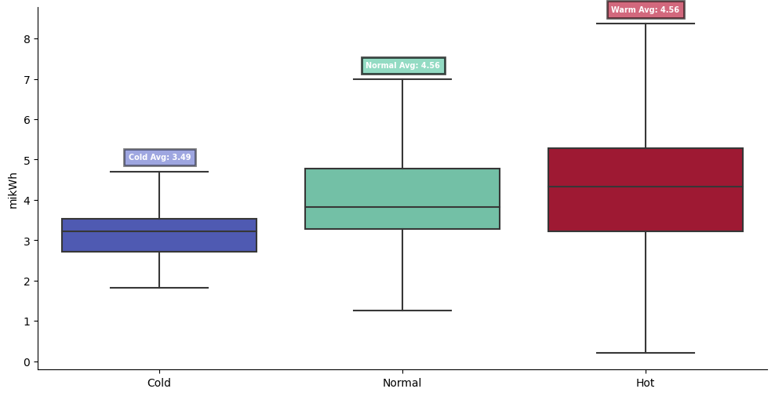

Slide 31

Myth #2: The cold weather limits the battery’s range
Notes:
So This Myth is definitely confirmed. -->
Cold temperatures negatively affect efficiency.
But how much of a degradation are we talking about?

Slide 32

Notes:
NEXT SLIDE

Slide 33


< 40°F
Notes:
With Temperatures below 40 Degrees F→

Slide 34

< 40°F
70 Miles Lost
Notes:
I calculated and average 70 miles lost in the Cold weather!!
That’s a decent amount of miles lost!
Anecdotally though, in my ownership of the car, I haven’t really noticed a difference in my normal daily driving. As seen in the data, most of my trips are 10 miles or less…so 70 miles off the top doesn’t really affect me until I have to go on a long trip!
As an example in terms of travel, from NYC it would mean the difference between driving to making it all the way to North Carolina or making it to South Carolina.
But let’s find out some more info here.

Slide 35

Cold: 231 mi
Norm: 279 mi
Hot: 300 mi
< 40°F
70 Miles Lost
Notes:
For specific numbers, If I charged my battery to 100% in each weather condition, ON AVERAGE I would get
231 miles MAX in cold weather
279 MAX in normal weather
And 300 MAX in Hot weather.
And back to that example before, In general with Electric Car Road trips I prefer to stop once to charge, so in an EXTREME circumstance If were to start and 100% and drain it to basically zero, I would get around 460 miles in the cold weather, and 600 miles in the Hot weather.
That amount of mileage is at the extreme of a car trip any way though.

Slide 36

Cold: 231 mi
Norm: 279 mi
Hot: 300 mi
< 40°F
70 Miles Lost
Cold: 3.49 mi/kWh
Norm: 4.23 mi/kWh
Hot: 4.56 mi/kWh
Notes:
And here are the efficiencies again. →

Slide 37

Cold: 231 mi
Norm: 279 mi
Hot: 300 mi
< 40°F
70 Miles Lost
Cold: 3.49 mi/kWh
Norm: 4.23 mi/kWh
Hot: 4.56 mi/kWh
Notes:
But what about the cost savings of these effeciencies?
That leads us into the THIRD MYTH!!

Slide 38

Myth #3: My electric bill will go through the roof charging a car at home; it’s cheaper to just fill up at a gas station.
Notes:
Myth #3: Is that it will be SO expensive to charge your own vehicle at home, and that it would just be cheaper to have a gas car and fill up at the gas station.
In order to address this myth, I will have to append TWO new data sets to my trip data, so that I can get a cost per trip analysis.
I’ll need to get Gasoline price data for NY, and I’ll need to get my Electricity prices and compare them.
Let’s start with my electric utility bill and see how much it costs.

Slide 39
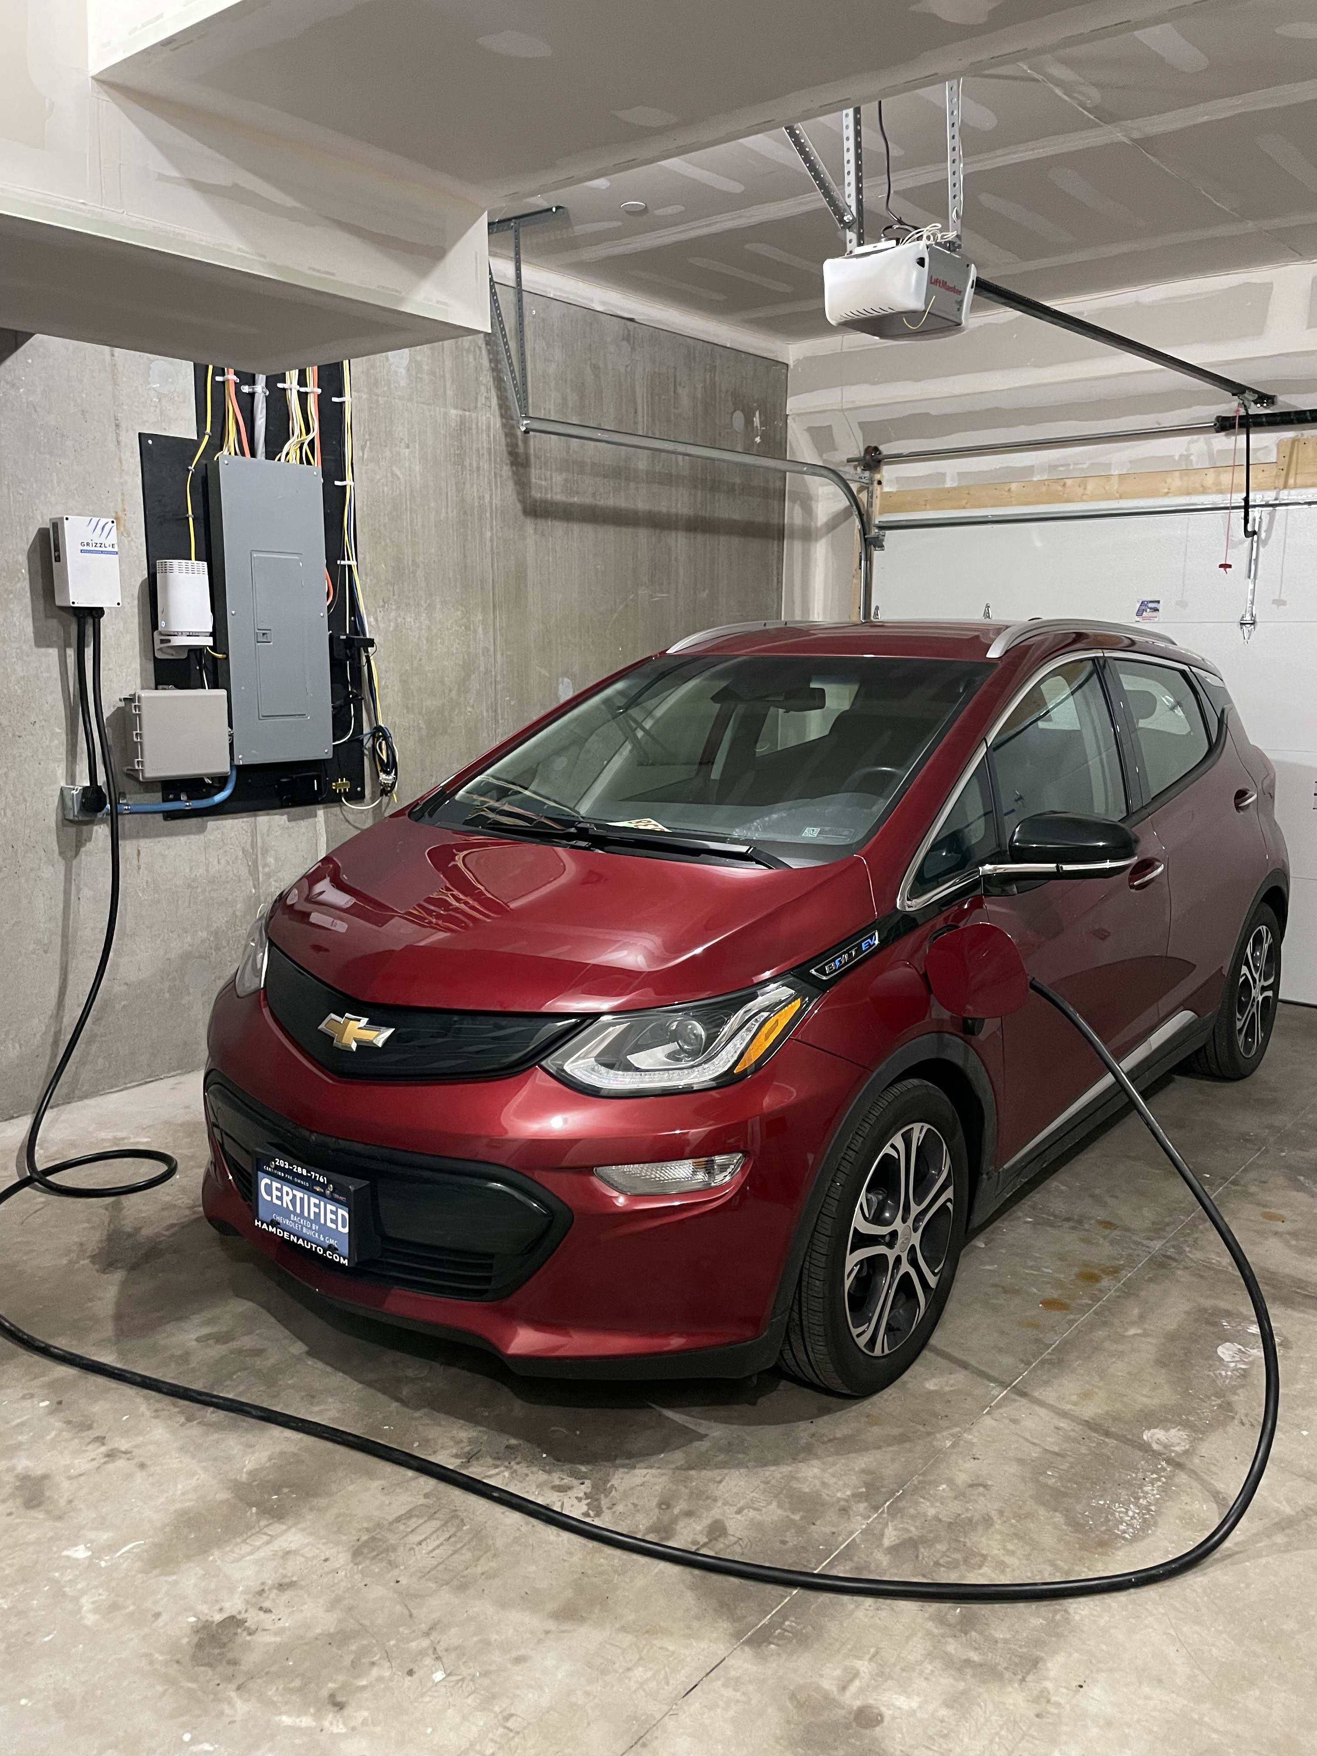
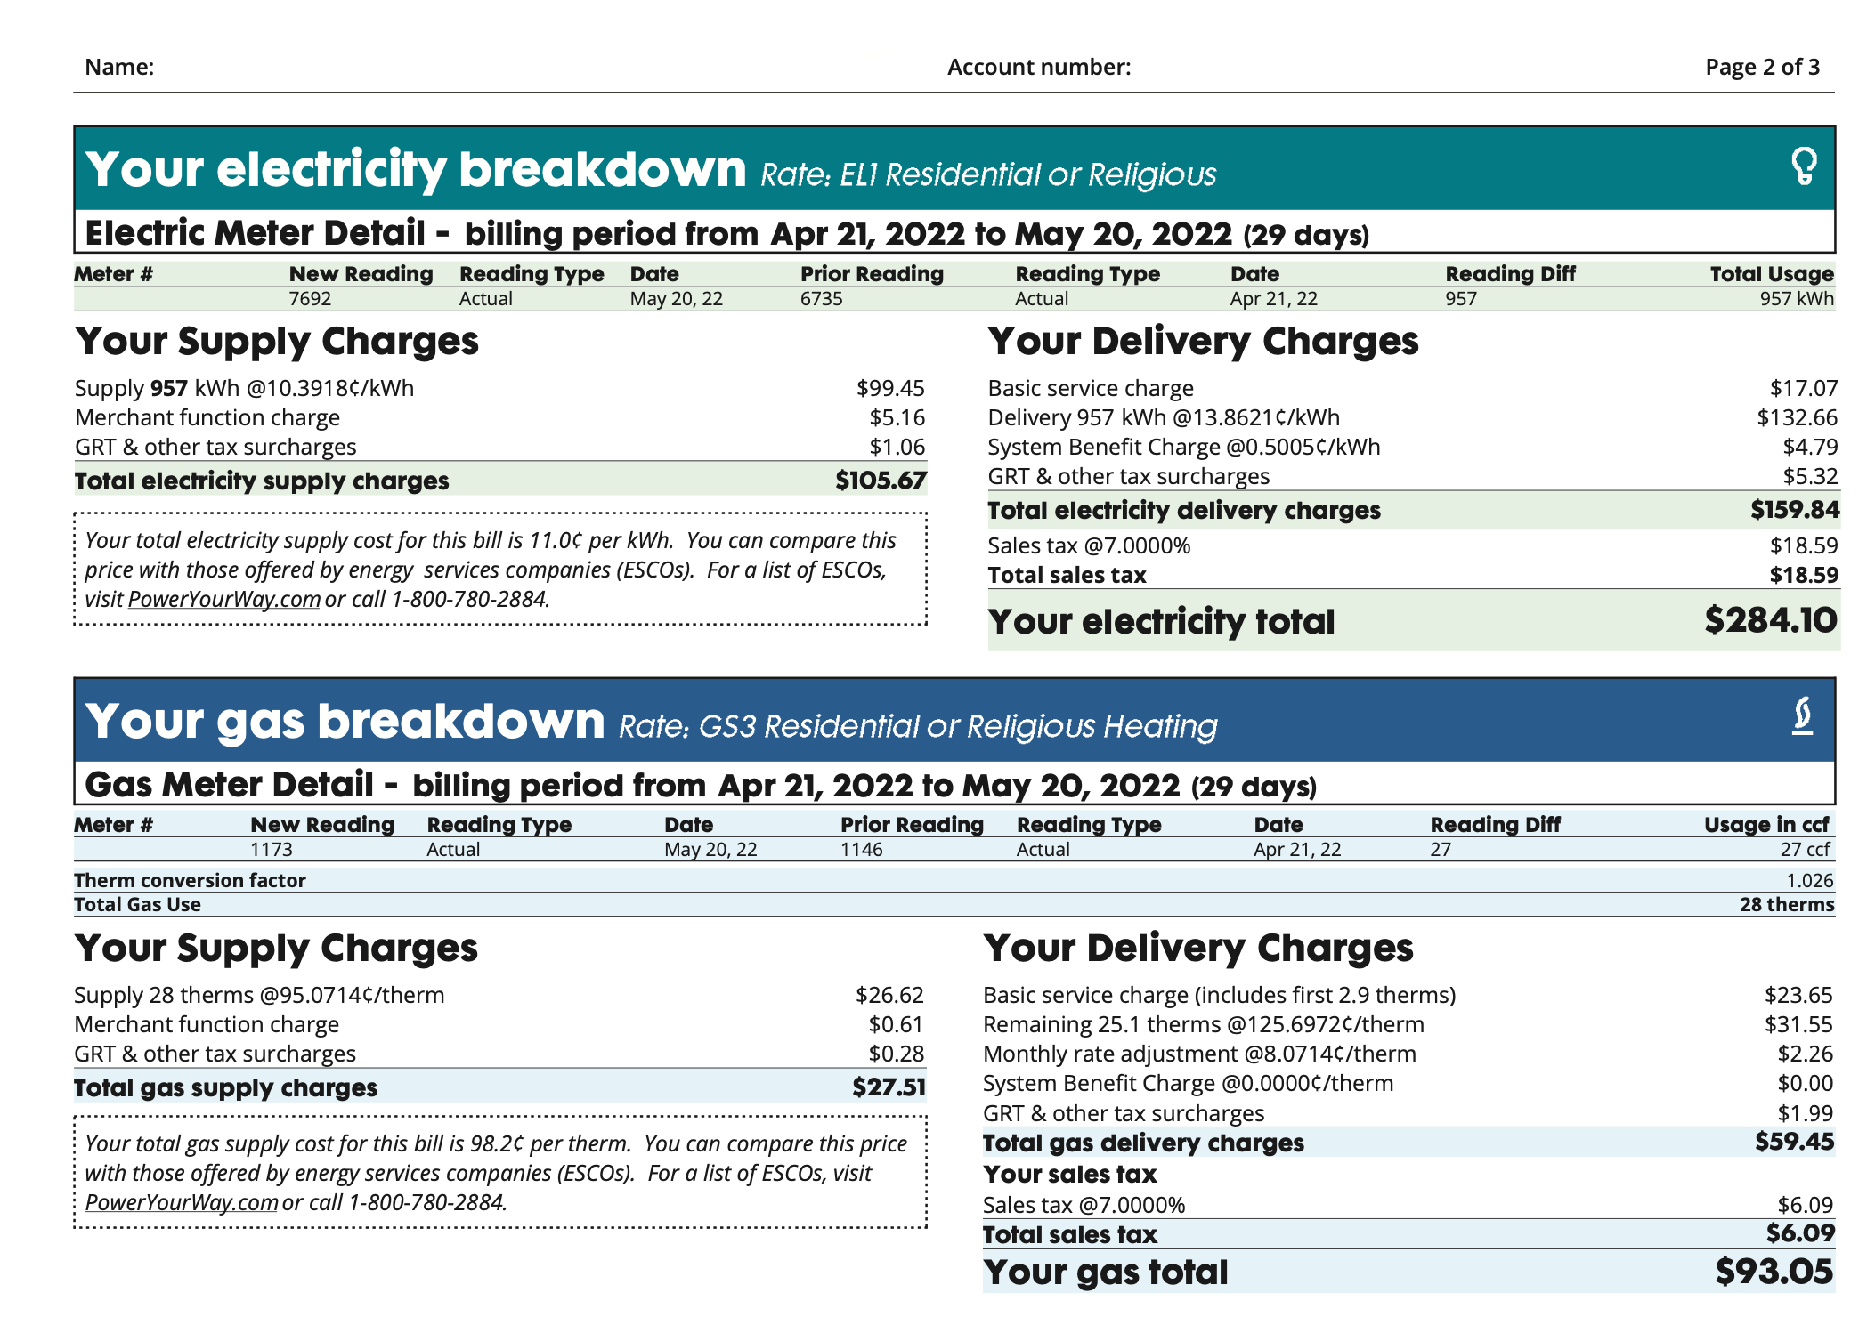
Scraping My Utility Bill
Notes:
→
So the context here is that most EV driver’s end every day by plugging their car into their home electrify and leave the car overnight to charge, (and I set it to charge at off peak times so it’s even cheaper.)
→
And everyone knows how crazy utility bills can get sometimes, so it is definitely understandable why this myth exists.
→
Because ConEd (my utility company) give me my bills in pdf, NOT .csv, I had to scrape the data from all of my bills over the past couple years to create and merge the specific data I needed from it into my trips dataset.
The data I needed was the date range, and the two different per kWh rates to add together for a final rate.
I won’t get into the specifics of this now for times sake, but if you have q’s about this, let me know after the presentation and I’d be happy to address them.
→

Slide 40
Electricity Cost
= $1,038.78
Notes:
So after scraping and merging the new dataset, I found out that I spent a total of $1,038.78 for the entire year on trips in my Chevy Bolt.
Is that good?
Not sure! Let’s try and compare that to a gas car as an example.

Slide 41
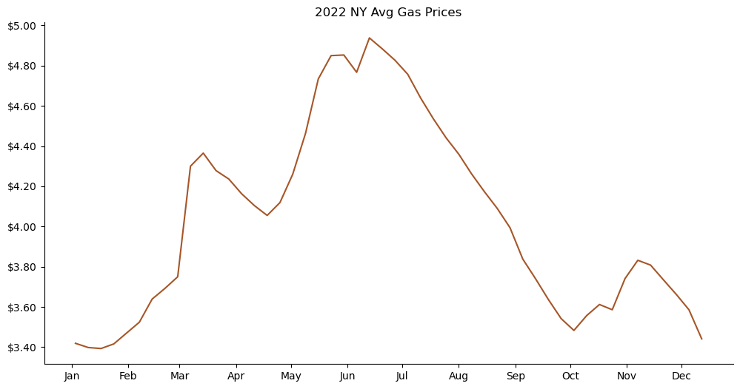
US EIA Weekly Gas Prices
Notes:
In Order to compare to what it would’ve cost in a gas vehicle, I was able to download public data from the US Energy Information Administration.
They log weekly averages into an online dataset that is easily downloaded into .csv
I Filtered the data to NY state and made sure to only look at REGULAR gasoline, not premium.
After cleaning and merging the data set to my trips dataset, I still was missing one giant piece of information!
I don’t have trip by trip data from another gasoline car to compare to.
So from here on out I’m going to be making an assumption on MPG’s of another Car in order to make a ROUGH comparison and address this myth.
The other car I’ll use is a 2005 Toyota Corlla which has an EPA combined MPG of 29.
Why this car, because it’s my other car, so if We weren’t using the BOLT, we would be completing these trips with that car.

Slide 42
Gas Cost
= $2,498.94
Notes:
So with that big Assumption of 29 miles per gallon on a gas car, if I made all of the same trips with my 2005 corolla, this year I would have spent :
→
$2,498,93
.
This data blew my mind a little bit. I was pretty sure the myth wasn’t true, but it was crazy to see HOW untrue it was.

Slide 43
Cost Savings
= $1,038,79
Notes:
So by GOING ELECTRIC, I was able to save $1,038.79.
It’s also really crazy to put an EXACT number to that with my personal experience, instead of some marketed number.
Let’s do one final deep dive with some visuals on the PER trip differences between Gas and Electric Car Costs.

Slide 44
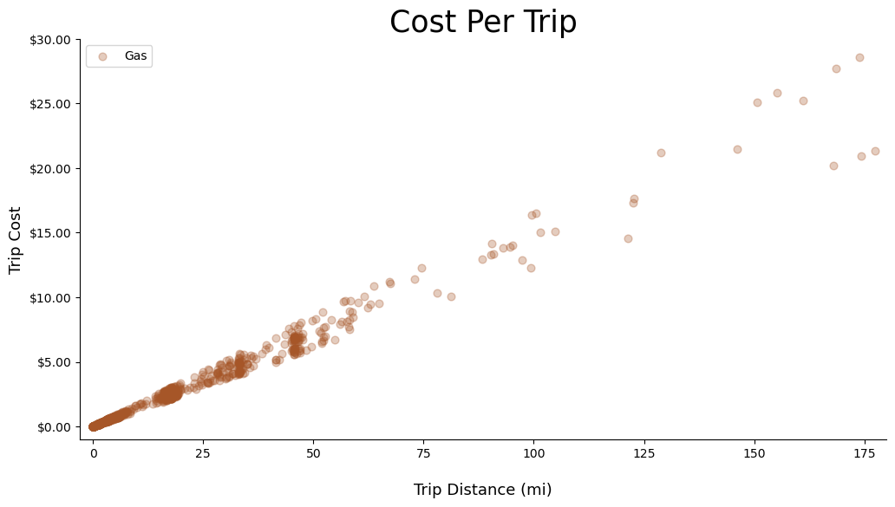
Notes:
I’ll start by plotting the assumed gas car trip data. I am comparing trip distance to that specific trips cost, based on the exact cost of gas that week the trip was taken.
All we can gather from this visual is that fact that the farther you drive, the more expensive the trip is…
Duh…
So lets add the Electric Car Trip Cost Data set in.

Slide 45
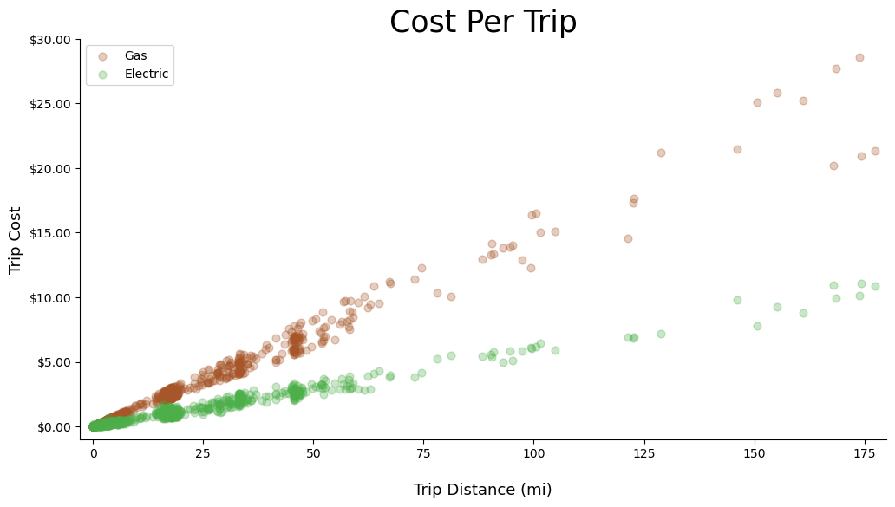
Notes:
Ah, we can clearly see a trend line for both
the brown dots represent the gas car
And the green dots represent the electric car. We can clearly see that the green dots all fall lower on the Y Axis that the brown dots.
But what was the average per trip ?

Slide 46

Notes:
AVERAGE TRIP COST for the gas car was $2.29→

Slide 47
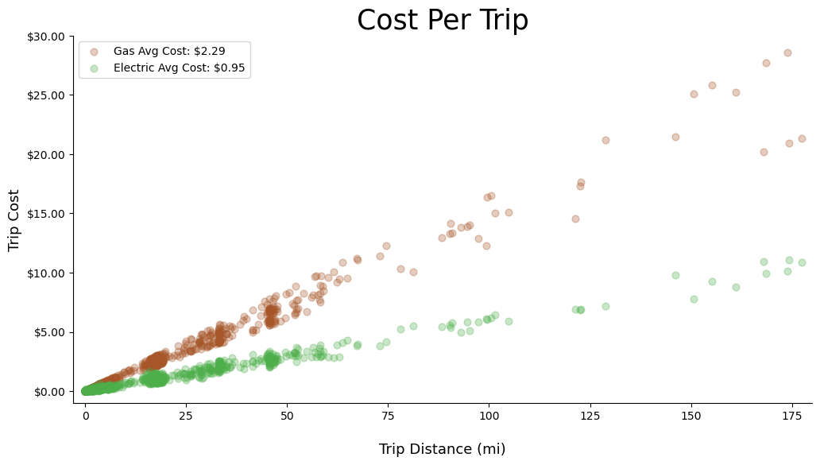
Notes:
And the average trip for the electric car cost $0.95
It costs more than TWICE the amount in “Fuel” Costs to drive a gas car compared to the Chevy Bolt.

Slide 48
Myth #3: My electric bill will go through the roof charging a car at home; it’s cheaper to just fill up at a gas station.
Notes:
Myth#3 is Clearly Busted.
In my experience, It is much cheaper to charge your vehicle at home than to fill up at a gas station.

Slide 49
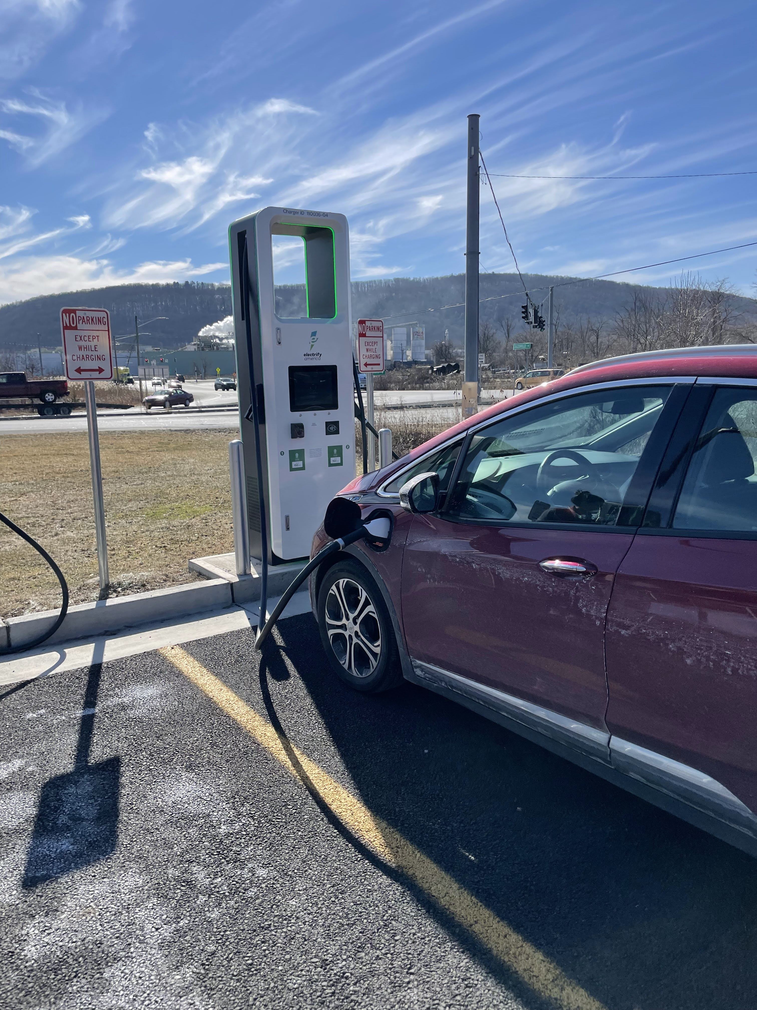
Wrapping Things up
Myth #1: EV’s can’t drive very far, and I’ll get stranded on the side of the road
Myth #2: The cold weather limits the battery’s range
Myth #3: My electric bill will go through the roof charging a car at home; it’s cheaper to just fill up at a gas station.
Notes:
So, let’s wrap up some ideas here.
After collecting data from over 100 trips over the course of almost a year, I was finally able to demystify those myths that plagued me leading up to my vehicle purchase.
Myth #1: EV’s can’t drive very far, and I’ll get stranded on the side of the road
I’ve proven that then can drive very far. The most I travelled in one day was over 300 miles, and the longest single stint was around 170 miles.
Myth #2: The cold weather limits the battery’s range
I proved this to be true, that the cold weather really does have an impact on my battery. I was able to give EXACT numbers so that if I know I need to make a long trip with my chevy bolt in the winter time I can better calculate how long I can drive compared to the Sumer
Myth #3: My electric bill will go through the roof charging a car at home; it’s cheaper to just fill up at a gas station.
We just proved it, that is twice as expensive to drive a typical gas car around, then an electric car.
Collecting all this data over the past year has been a super awesome project that I’m so happy that it culminated here with my first Data Science Academy project.
I think we are the beginning of a very interesting age of personal data collection,
and I think it’s so important to empower the individual to take advantage of that data to make their lives better.
Don’t let the big tech companies be the ONLY ones who benefit from this wealth of data.

Slide 50
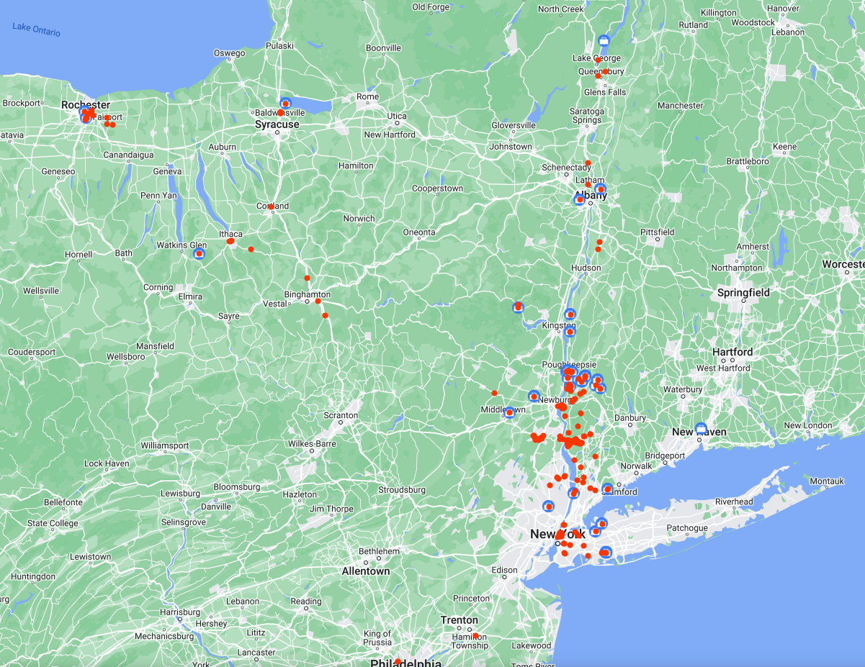
Future Ideas
Merge my google maps data
Upgrade OBDII device
Charging station data
Consider different lifestyles
More Cars
Notes:
→Merge my trip data with my google maps timeline to get access to geographic data. This is possible but require a SGINGICICANT amount of work
→Start the data collection again, but this time with an upgraded obdII sensor to collect GPS data
→I could look at things like elevation changes and compare it to my trip data.
→I could also pull the data from charging on the go trips, and compare those costs to my at home costs.
I might Also consider different living situations. My data is very scewed to the fact that I could pull into my garage every night and charge my car. That’s a huge assumption which means this data can’t really compare with someone who lives in an apartment and needs to use public chargers all the time. I could also consider different areas of the US, different temperature ranges, climates, and elevation changes.
AND LASTLY I could replicate this across MANY cars, and collect a whole database of information about a fleet of different cars, something like consumer reports.
NEXT SLIDE

Slide 51
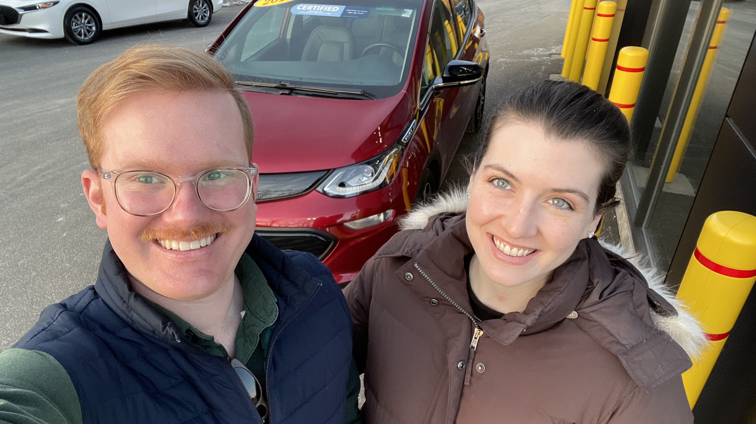
"Data isn’t units of information. Data is a story about human behavior - about real people's wants, needs, goals and fears. Never let the numbers, platforms, charts and methodologies cloud your vision. Our real job with data is to better understand these very human stories, so we can better serve these people. Every goal your business has is directly tied to your success in understanding and serving people."
~ Daniel Burstein
Notes:
I’d like to end my presentation with this quote from Daniel Burstein.
THANK YOU

